Slide 1
ONLINE BUS REGISTRATION FORM
Submitted by: Submitted to:
V . Hyndavi Reddy -160116737066 Dr Smriti Agrawal
N .Sai Nikhita-160116737076

Slide 2
MOTIVATION
In Cbit the bus fee registration for a student is very tedious and time taking task .
Reason behind it is the students to take registration forms which involves to choose their bus number which after submitting receipt is given.
To make it digital and time saving, we were motivated to do this project.

Slide 3
SOFTWARE REQUIREMENTS
Operating system : Windows 8.1 64bit
Front end : Html , Php
Back end : Mysqli database
Documentation tool : Microsoft office(2007)
Server tool : Wampserver

Slide 4
INTRODUCTION
Our main page consists of admin login and a click here button for students which will take them to the registration form . Admin login in which he can check the student details . Students can register for the bus facility

Slide 5
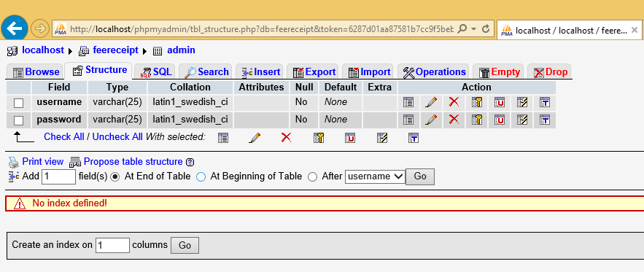
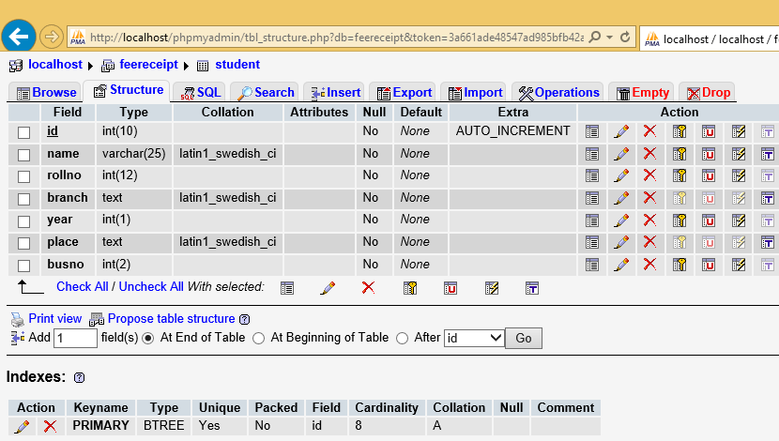

Slide 6
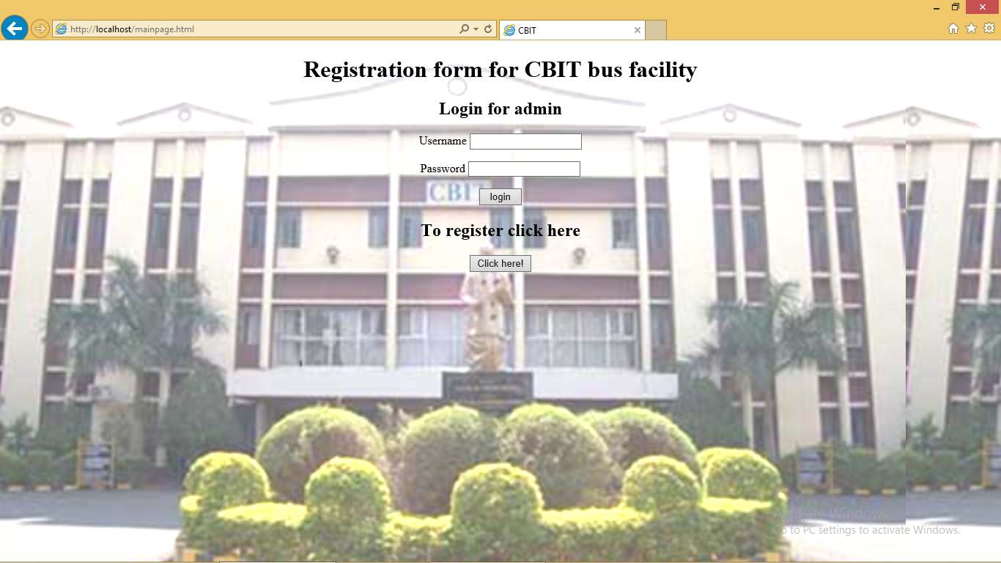
IMPLEMENTATION
MAIN PAGE:

Slide 7
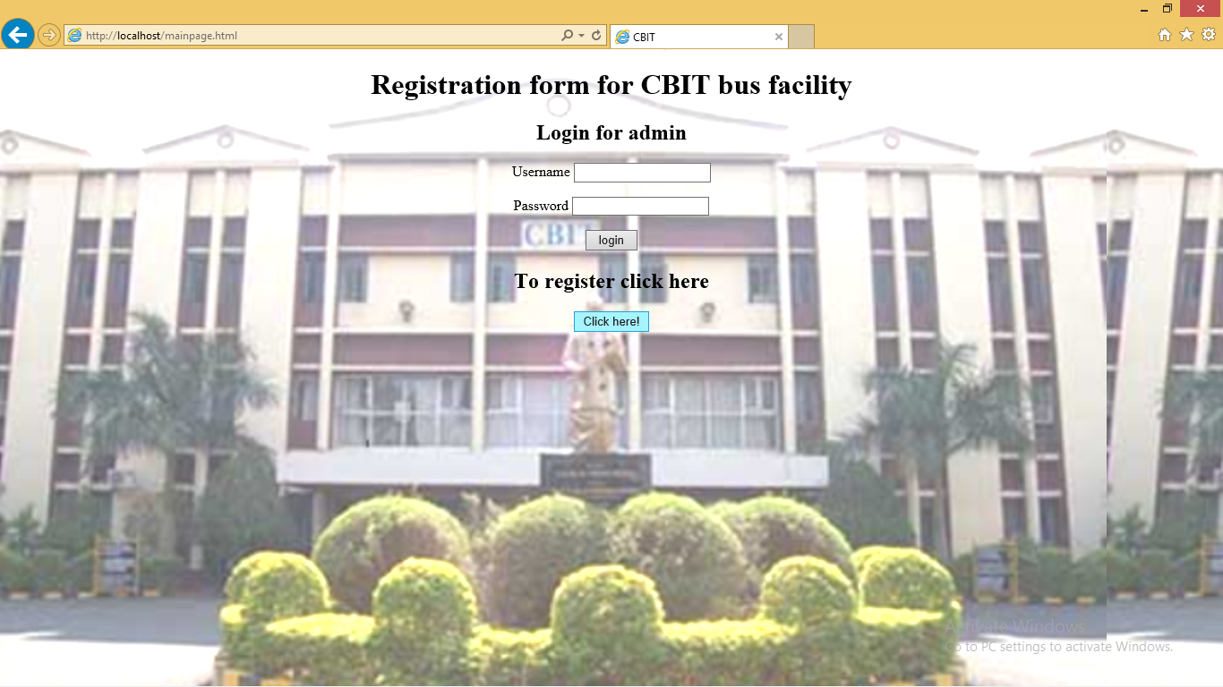
CLICK HERE OPTION

Slide 8
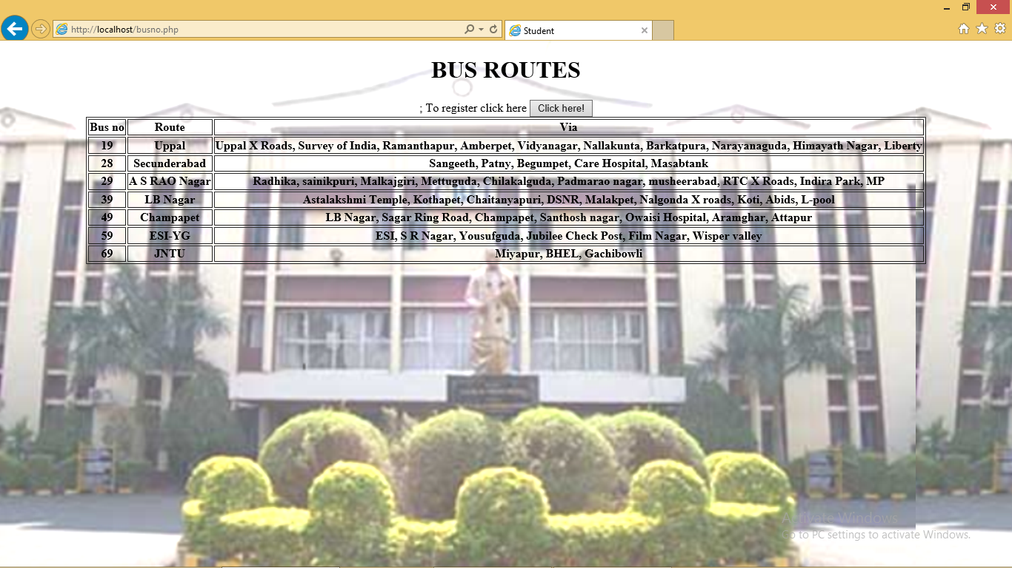
BUS ROUTES

Slide 9
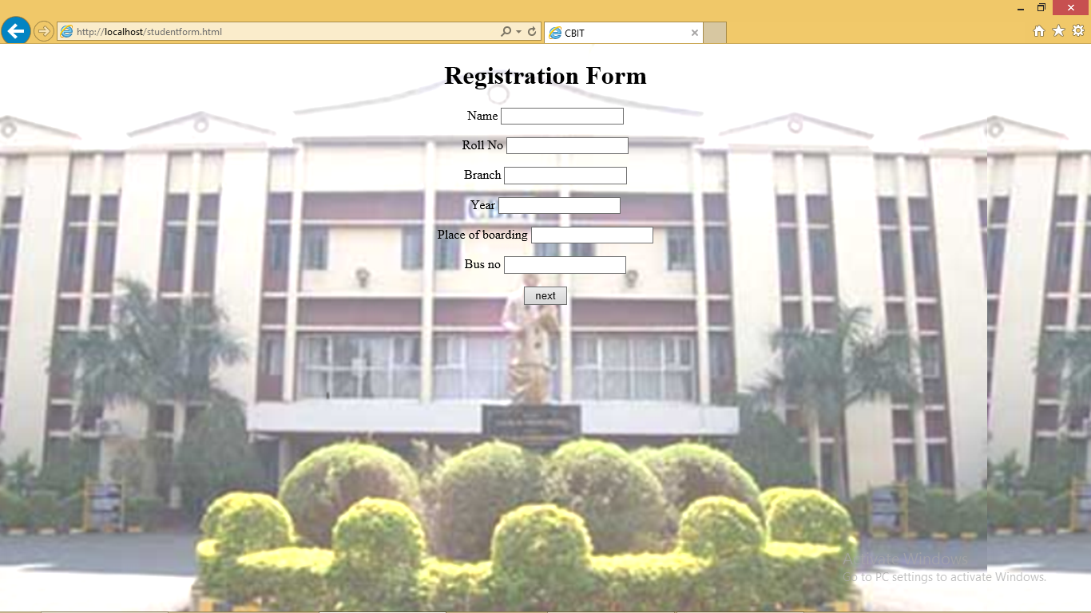
REGISTRATION FORM

Slide 10
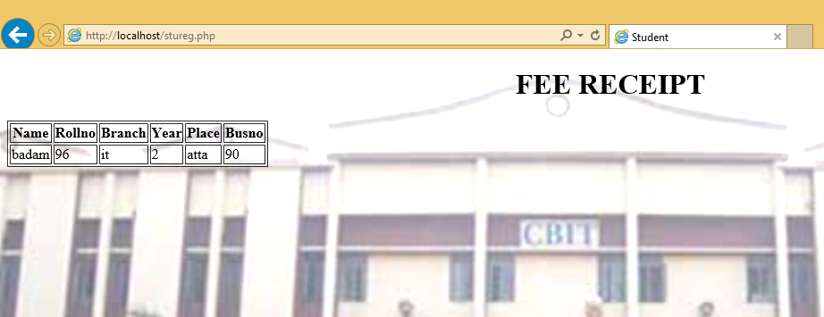
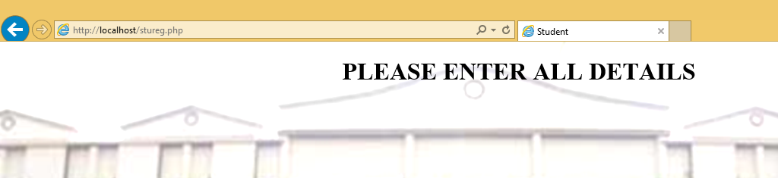
SUCCESSFUL AND UNSUCCESSFUL REGISTRATIONS

Slide 11
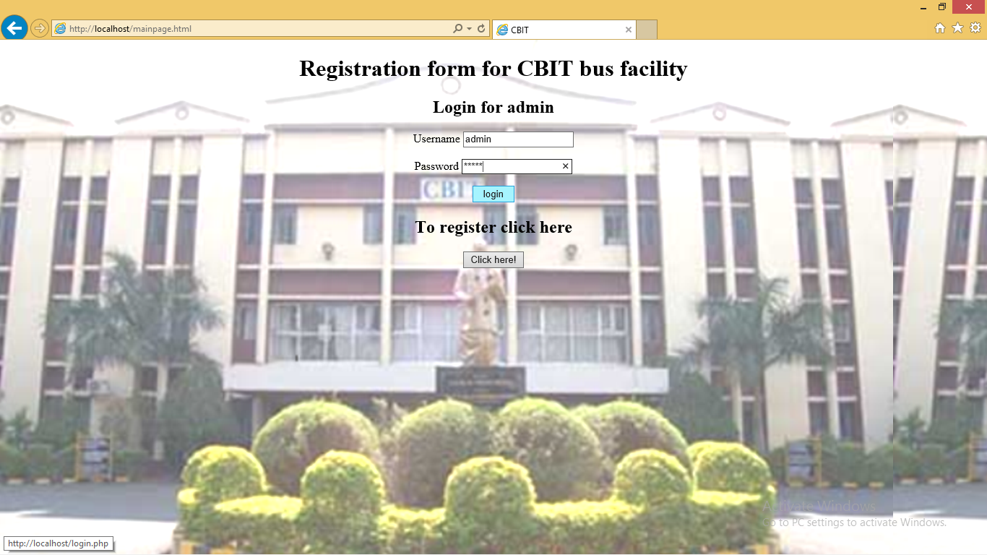
ADMIN LOGIN

Slide 12
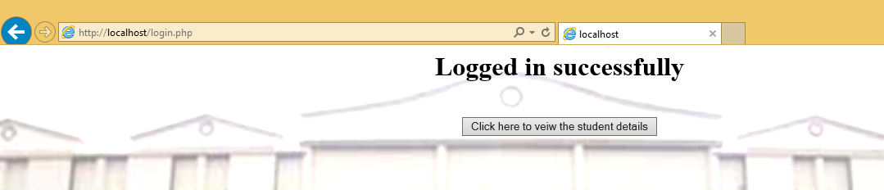
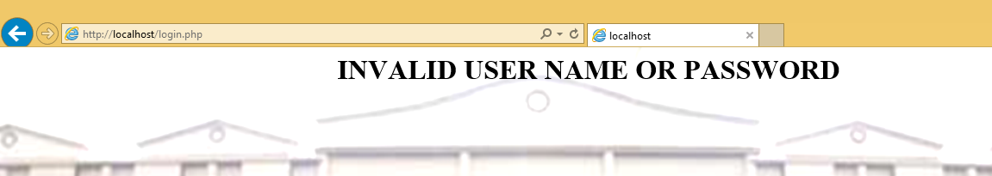
UNSUCCESSFUL AND SUCCESSFUL LOGIN

Slide 13
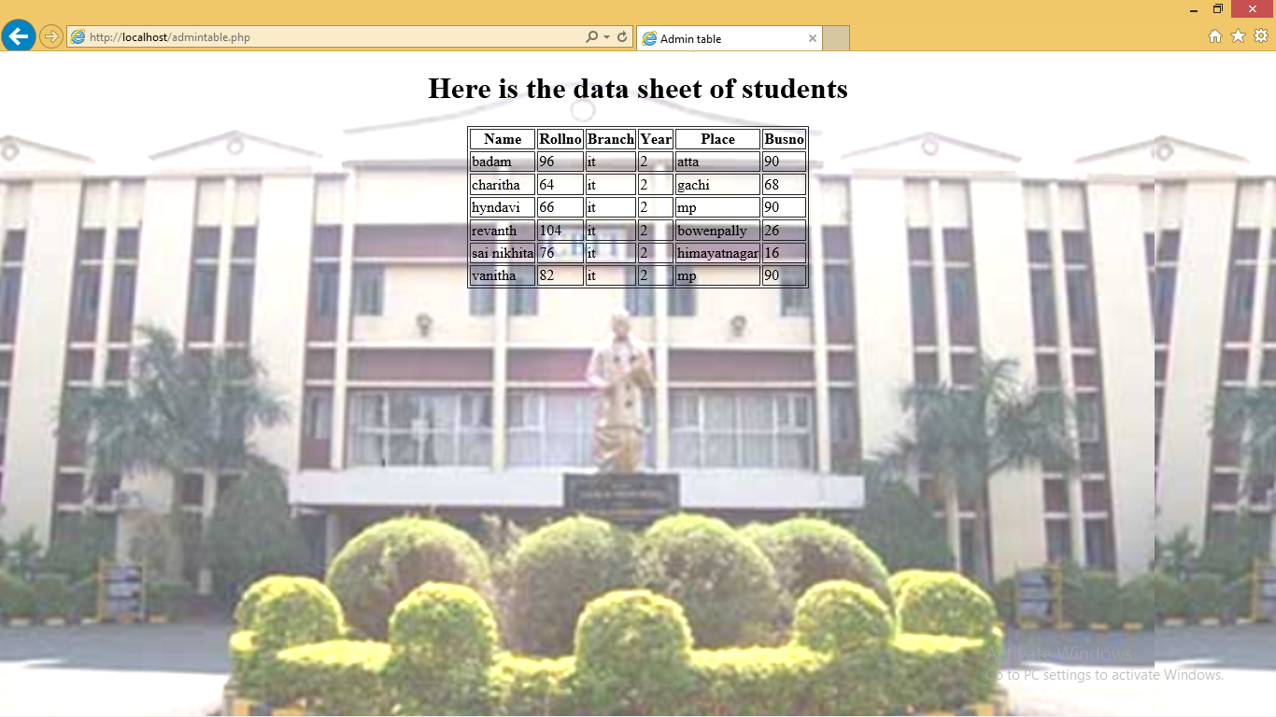
STUDENT DETAILS

Slide 14
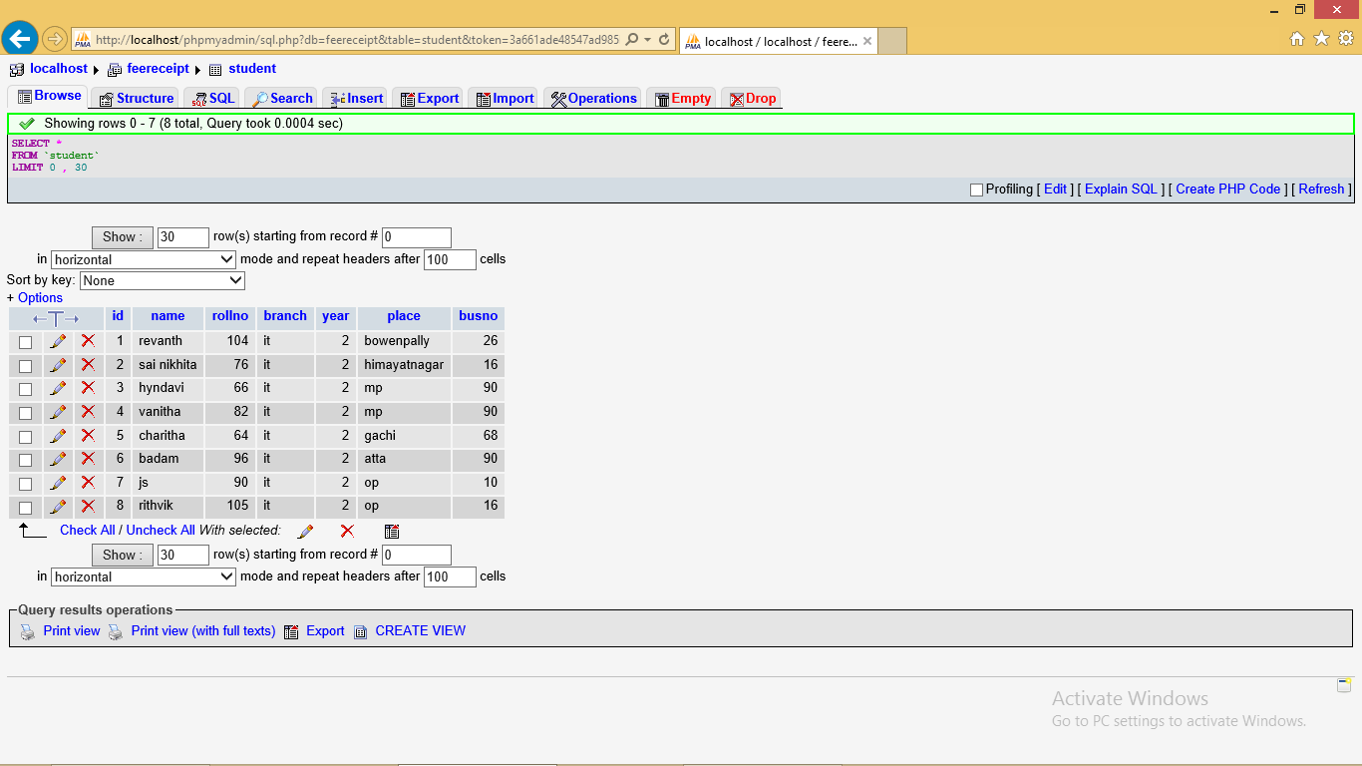

Slide 15
APPLICATIONS AND ADVANTAGES
APPLICATIONS
Any registration form processes
ADVANTAGES
Easy process
Time saving
Efficient storage

Slide 16
FLOWCHART
Start
Admin login
Click here option
Main page
Bus Routes
Student details
Registration form
Receipt
Stop

Slide 17
CONCLUSION
This online registration form will be very useful and timesaving
The problem statement which we thought of is achieved to the maximum extent.

Slide 18
Thank you

